Slide 1
The Atlantic slave trade: Investigating primary sources
Scotland and the Caribbean

Slide 2
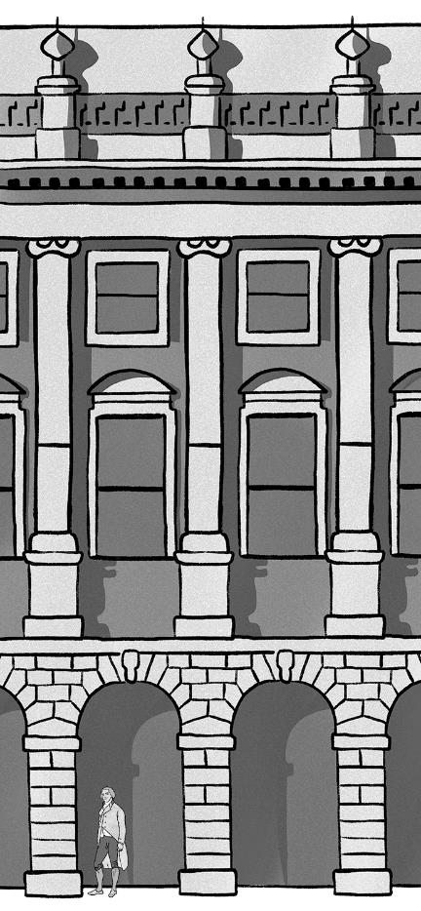
Introduction
The story of Scotland’s economic success is inseparable from slavery. The wealth created through the Atlantic slave trade helped shape the course of Scottish industrialisation during the 18th and 19th centuries, creating lasting impacts to the present day. Use this PowerPoint alongside the Scotland and the Caribbean resource sheet to explore objects in our collections as primary sources of evidence.

Slide 3
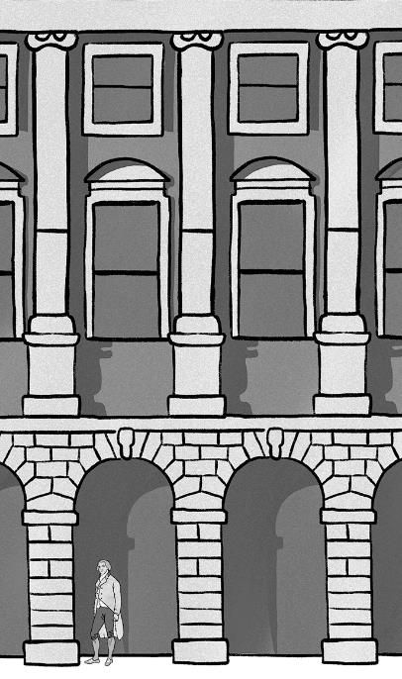
Scotland’s rising wealth
The economic impact of the Atlantic slave trade and wider slavery system on Scotland can be seen in various ways:
the growth of industries
the rising wealth of merchants and manufacturers
Please use the Scotland and the Caribbean resource sheet (page 1) for further information.

Slide 4
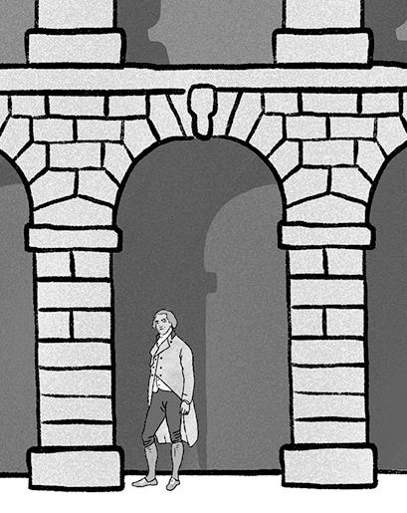
Initial discussion
Evidence of the wealth generated through the Atlantic Slave trade can still be seen in Scotland's towns, cities and countryside today.
In pairs or groups, think about what this evidence might be?

Slide 5
Objects as evidence
The following objects provide evidence of Scotland's rising wealth and its connections to the Caribbean through the Atlantic slave trade.

Slide 6
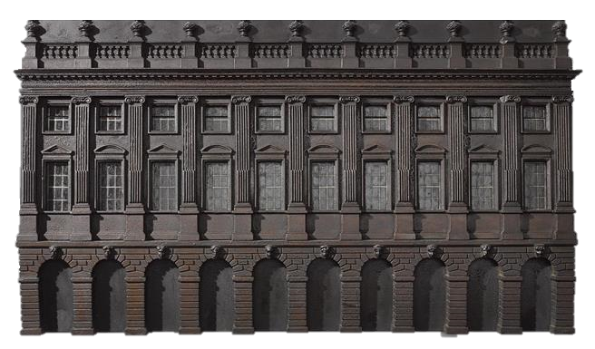
Scotland and the Caribbean Object one
Dimensions: Length: 97.0cm, Height: 55.5cm, Depth: 5.0cm

Slide 7
Exploring the object
What can you see? How would you describe the object?
What is it made from?
What do you think it might have been used for?
What is it?

Slide 8
What is this object?
An architect’s model of the first Glasgow town house, or town hall.
The model was made from mahogany wood, around the year 1756.
The building itself was designed and built by Allan Dreghorn and Mungo Naismith.
Please use the Scotland and the Caribbean resource sheet (page 2) for further information.

Slide 9
Discussion questions
Please use the Scotland and the Caribbean resource sheet (pages 2 & 3) for further information to support your discussions.

Slide 10
What words would you use to describe this model? How does the building compare with...
your house?
your school?
your local library or museum?
other buildings in your neighbourhood?

Slide 11
Who do you think might have visited or used this building?
Have you seen buildings like this one before?
What impression do you think the architect was trying to make on passers-by?

Slide 12
Research

Slide 13
Research the material this object is made from:
What is mahogany wood?
Where did it come from?
Who chopped the trees down?
How did mahogany wood end up in Scotland?

Slide 14
Research any local grand buildings which remind you of the Glasgow town house.
Find out:
when they were built
who funded them
if they were connected to the Atlantic slave trade?

Slide 15
Reflect
How do you think the links between profits made from slavery and buildings in our towns and cities should be recognised and represented?

Slide 16
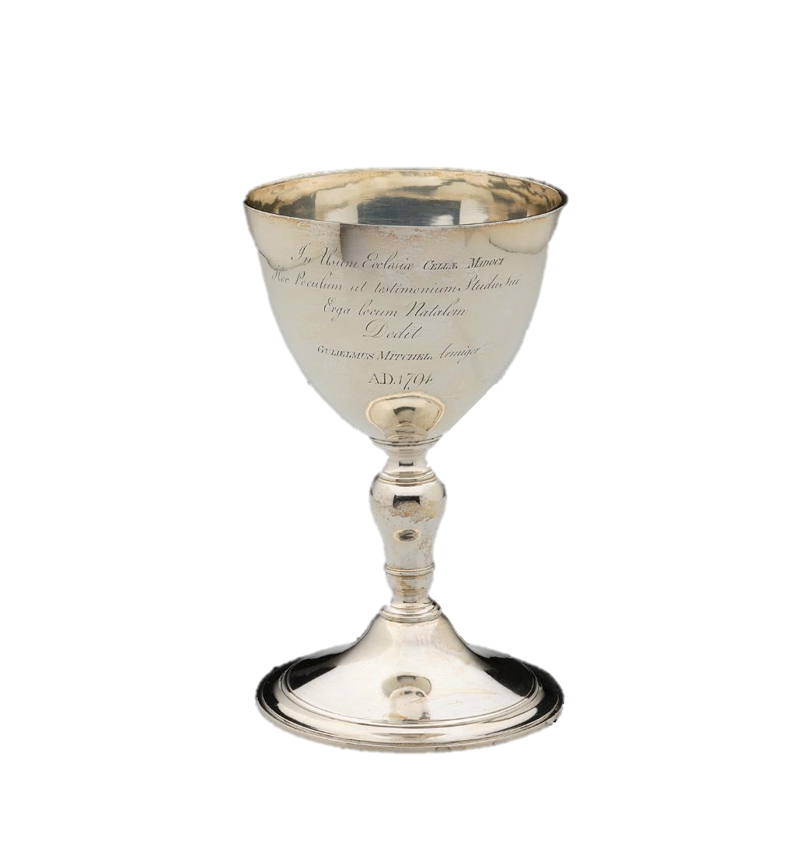
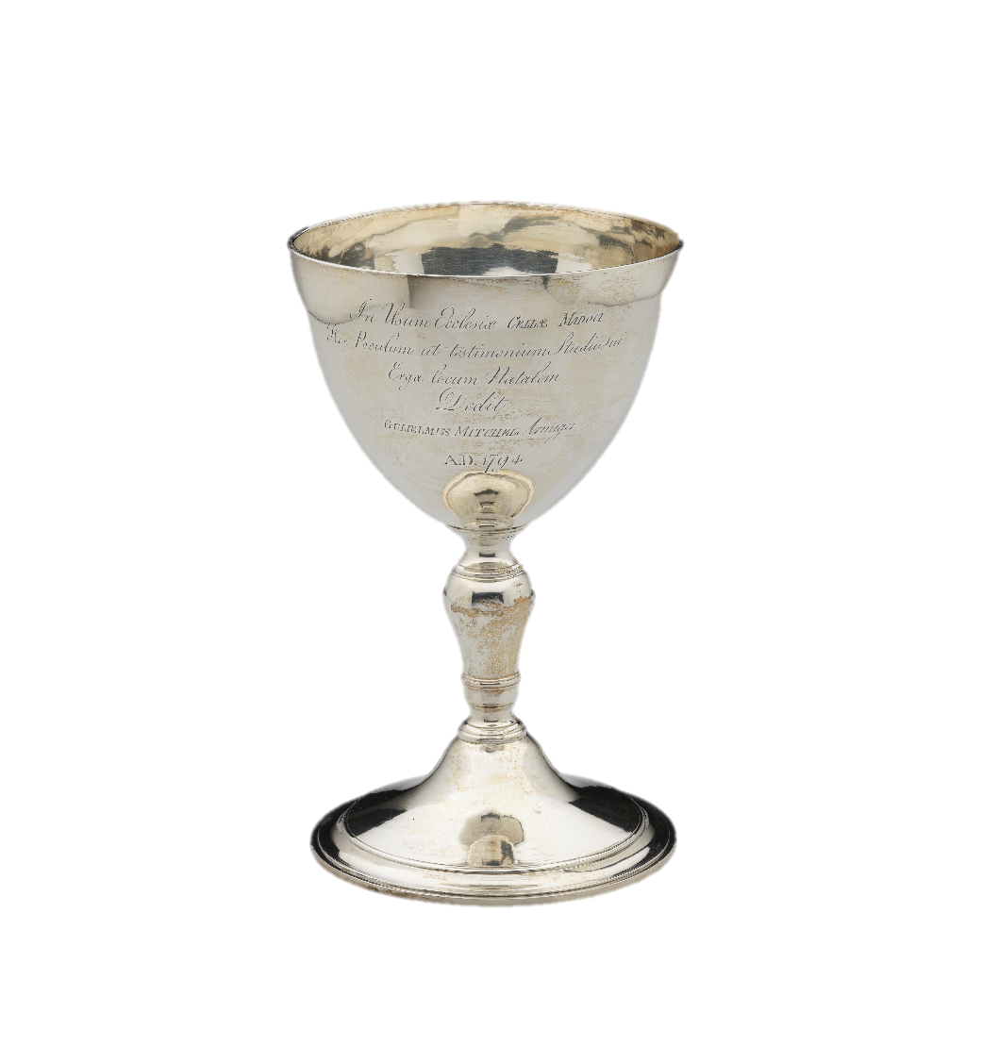
Scotland and the Caribbean Objects two and three
Dimensions of each:
Height: 23.3cm
Diameter at rim and base: 14.7cm

Slide 17
Exploring the objects
What are they made from?
What can you see? How would you describe the objects?
What do you think they might have been used for?
What are they?

Slide 18
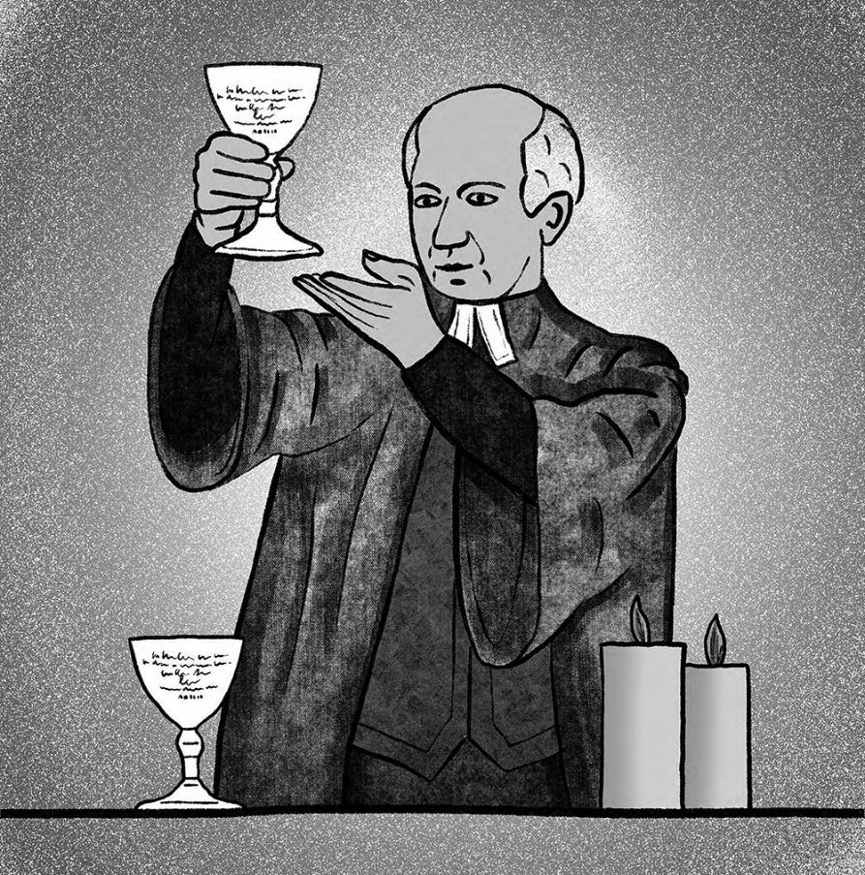
What are these objects?
Two silver communion cups, originally part of a set of four.
Made around 1794.
Commissioned from an Edinburgh silversmith.
Gifted to Kilmadock Parish Church in Doune, Stirlingshire, by William 'King' Mitchell - a Scot who owned many enslaved people on his plantations in Jamaica.
Please use the Scotland and the Caribbean resource sheet (page 4) for further information.

Slide 19
The Latin engraving on the cups can be translated as follows:
‘For the use of Kilmadock Church this cup is given by William Mitchell, gentleman, as evidence of a mark of respect for his birthplace, AD 1794’.

Slide 20
Discussion questions
Please use the Scotland and the Caribbean resource sheet (pages 4) for further information to support your discussions.

Slide 21
What material was used to make the communion cups?
What does this tell us about William Mitchell, the man who gifted them to the church?

Slide 22
What does the Latin inscription tell you about their donor?
Why do you think William Mitchell commissioned and donated these silver communion cups to the church?

Slide 23
Why do you think William Mitchell was given the nickname ‘King Mitchell’ in Jamaica?

Slide 24
Research
Research the biography of William Mitchell.
How does his life story help us understand Scotland’s involvement in the Atlantic slave trade?

Slide 26
The next three slides contain the following additional materials to support classroom learning:
Higher resolution images of the key objects
Optional timers to use for the group discussions

Slide 27
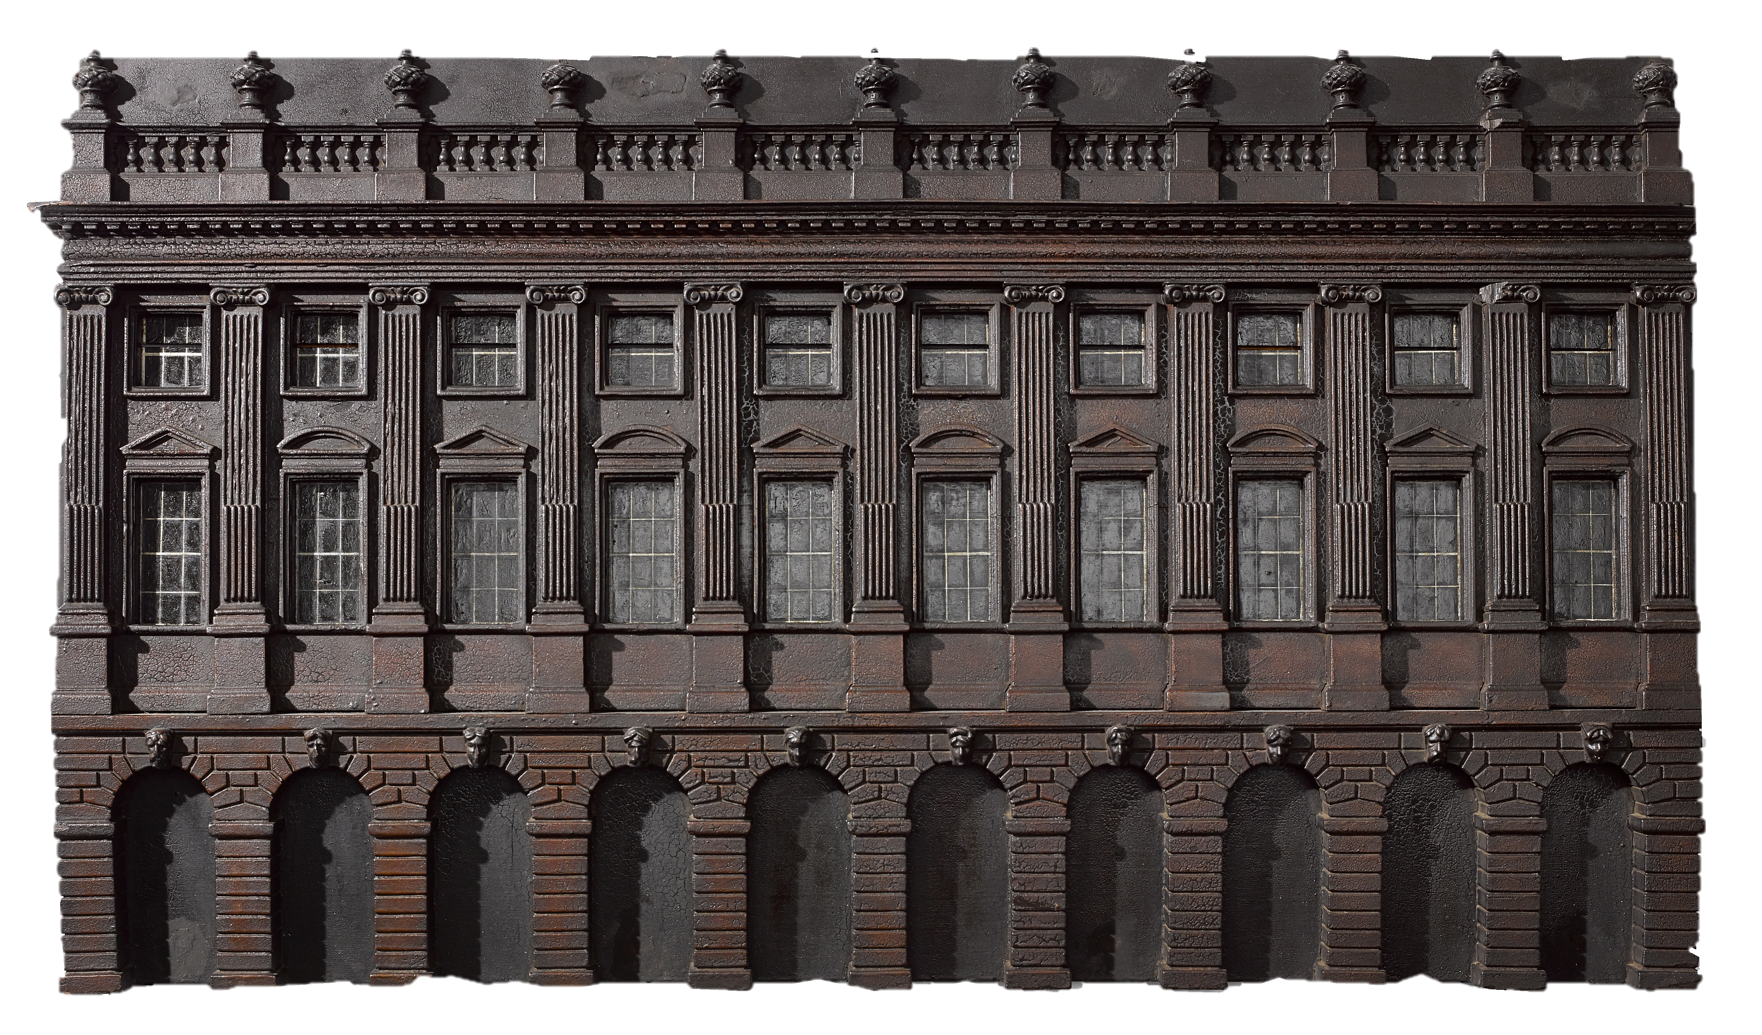

Slide 29
Optional timers for discussion questions
2 minutes
3 minutes
4 minutes
5 minutes
Timers provided by Training and Consultancy Ltd.
To use, select both elements of the timer (written minutes and circle) and paste to required slide.
The timer will begin on mouse click.

